Slide 1
UNSTRUCTURED DATA (TWITTER) AND STRUCTURED DATA (NETFLIX)
By - Shefali Kamalnakhawa
Instructor Name – Charles Edeki

Slide 2
CONTENTS
DataFrames
Data Types
Drop null values, Missing values or duplicate values
Box plot and histogram
Pair plot
Scatter plot
Merging two DataFrames
Slicing The Data
Represent in the matrix form
Use Conditions
Using Statistical libraries
Classify according to categories
Use of libraries like Pandas, Numpy, Matplotlib, Seaborn

Slide 3
TWITTER UNSTRUCTURED DATA

Slide 4
LOADING DATA IN TO DATAFRAMES
First, I imported the twitter library and set the authorization tokens. The consumer key, consumer secret will be available on the Keys and Access Tokens tab on your Twitter app’s page. To get the access tokens, we need to click on the Create my access token button, which is on the same page. Enter the keys into the appropriate places in the following code:
consumer_key = "hlJQDetGOgp2hkHqquIz9Q4id"
consumer_secret = "goiuPBawHOYGMP8Z1LCXxAaFYTtsxkLxdczvrNqIhJ7u9Mg1zJ"
access_token = "3718471092-xCxN8NGbZSi4ERojU9iwiU1pT9NnOPdrN6gQXNp"
access_token_secret = "qhbbArLOc1iIAEXZGjcaYKuqxBXl5dRQJUQeStM37xGlL"
authorization = twitter.OAuth(access_token, access_token_secret, consumer_key, consumer_secret)

Slide 5
We are going to get our tweets from Twitter’s search function. We will create a reader that connects to twitter using our authorization, and then use that reader to perform searches. In the Notebook, we set the filename where the tweets will be stored:
import os
output_filename = os.path.join(os.path.expanduser("~"), "Data", "twitter", "python_tweets.json")
We also need the json library for saving our tweets:
import json
Next, create an object that can read from Twitter. We create this object with our authorization object that we set up earlier:
t = twitter.Twitter(auth=authorization)
We then open our output file for writing. We open it for appending—this allows us to rerun the script to obtain more tweets. We then use our Twitter connection to perform a search for the word Python. We only want the statuses that are returned for our dataset. This code takes the tweet, uses the json library to create a string representation using the dumps function, and then writes it to the file. It then creates a blank line under the tweet so that we can easily distinguish where one tweet starts and ends in our file:
with open(output_filename, 'a') as output_file:
search_results = t.search.tweets(q="python", count=100)['statuses']
for tweet in search_results:
if 'text' in tweet:
output_file.write(json.dumps(tweet))
output_file.write("nn")

Slide 6
CHECK THE DATA TYPES OF YOUR DATA COLUMNS
All Twitter APIs that return Tweets provide that data encoded using JavaScript Object Notation (JSON). JSON is based on key-value pairs, with named attributes and associated values. These attributes, and their state are used to describe objects. At Twitter we serve many objects as JSON, including Tweets and Users.
Next, we will loop through each of the tweet ids, and ask twitter to recover the original tweet. A good feature of twitter's API is that we can ask for 10,000 tweets at a time, drastically reducing the number of API calls. Interestingly, from twitter's point of view, it is the same number of calls to get one tweet or 10,000 tweets, as long as it is a single request.

Slide 7
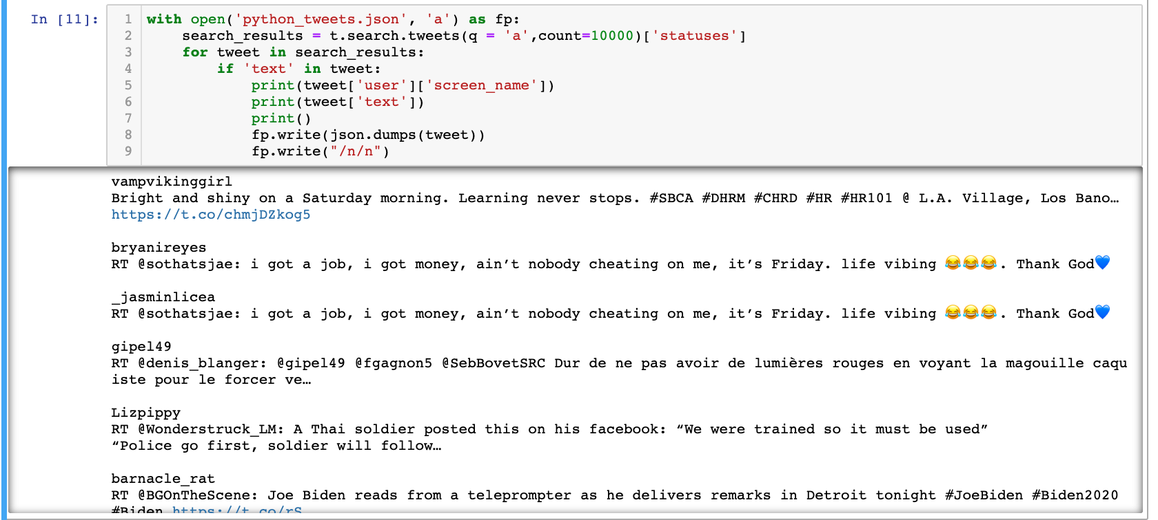

Slide 8
LOADING AND CLASSIFYING THE DATASET
After we have collected a set of tweets (our dataset), we need labels to perform classification. We are going to label the dataset by setting up a form in an IPython Notebook to allow us to enter the labels.
The dataset we have stored is nearly in a JSON format. JSON is a format for data that doesn’t impose much structure and is directly readable in JavaScript (hence the name, JavaScript Object Notation). JSON defines basic objects such as numbers, strings, lists and dictionaries, making it a good format for storing datasets if they contain data that isn’t numerical. If your dataset is fully numerical, you would save space and time using a matrix-based format like in NumPy.
A key difference between our dataset and real JSON is that we included newlines between tweets. The reason for this was to allow us to easily append new tweets (the actual JSON format doesn’t allow this easily). Our format is a JSON representation of a tweet, followed by a newline, followed by the next tweet, and so on.
To parse it, we can use the json library but we will have to first split (/n) the file by newlines to get the actual tweet objects themselves.

Slide 9
Json file
I set up a new IPython Notebook (I called it as python_tweets.json) and entered the dataset’s filename. This is the same filename in which we saved the data in the previous section. We also define the filename that we will use to save the labels to. The code is as follow:

Slide 10
We are now interested in classifying whether an item is relevant to us or not (in this case, relevant means refers to the programming language Python). I used the IPython Notebook’s ability to embed HTML and talk between JavaScript and Python to create a viewer of tweets to allow us to easily and quickly classify the tweets as spam or not.
The code will present a new tweet to the user (you) and ask for a label: is it relevant or not? It will then store the input and present the next tweet to be labeled.
First, I create a list for storing the labels. These labels will be stored whether the given tweet refers to the programming language Python, and it will allow our classifier to learn how to differentiate between meanings.

Slide 11
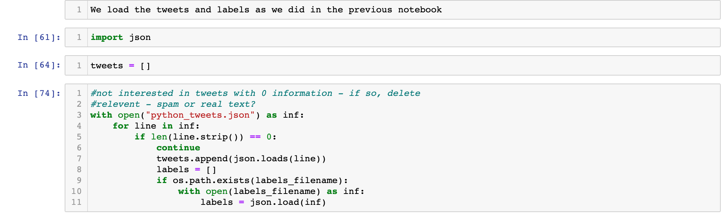
We also check if we have any labels already and load them. This helps if you need to close the notebook down midway through labeling. This code will load the labels from where you left off. It is generally a good idea to consider how to save at midpoints for tasks like this. It hurts quite like losing an hour of work because your computer crashed before you saved the labels! Next, I create a simple function that will return the next tweet that needs to be labeled. We can work out which is the next tweet by finding the first one that hasn’t yet been labeled. The code is as follows:

Slide 12
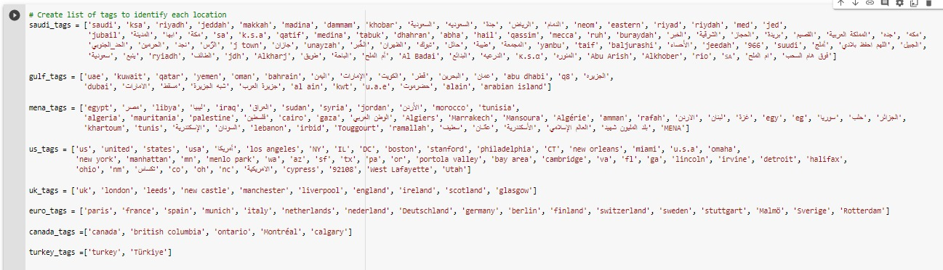
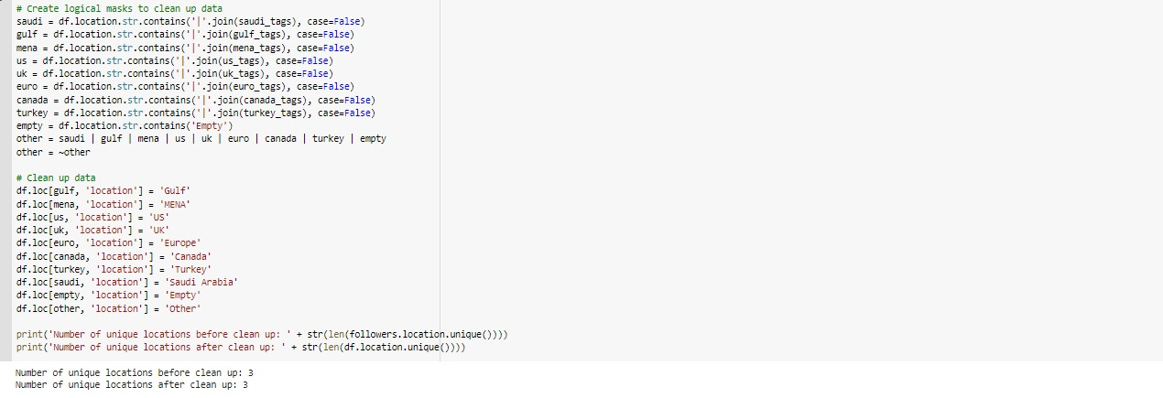
DROP ANY NULL, MISSING VALUES OR UNWANTED COLUMNS
First, I created list of tags to identify each location. We then created logical masks to clean up data and clean up data by renaming. This resulted in only having unique locations.

Slide 13
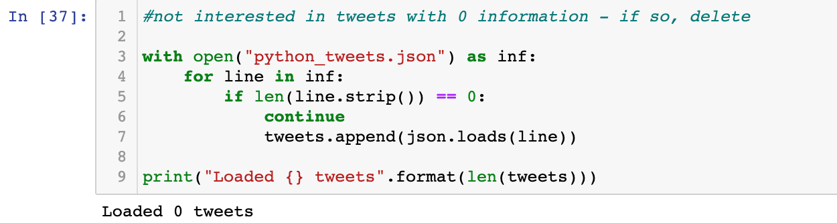
DROP DUPLICATE VALUES
Then iterate over each line in the file. I am not interested in lines with no information (they separate the tweets for us), so check if the length of the line (minus any whitespace characters) is zero. If it is, ignore it and move to the next line. Otherwise, load the tweet using json.loads (which loads a JSON object from a string) and add it to our list of tweets. The code is as follow:

Slide 14
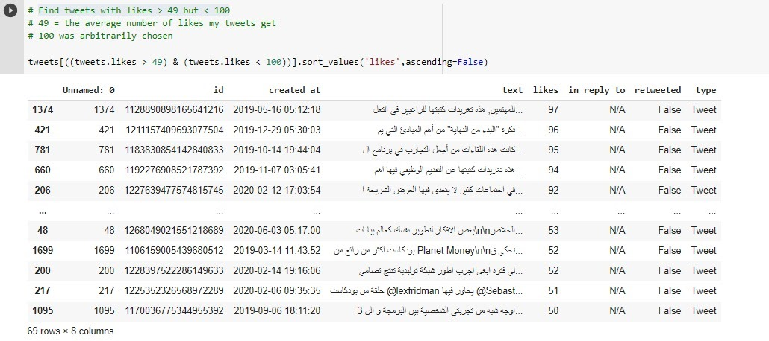
Ran a query to find tweets with likes > 49 and < 100. We chose random range. Below is the result of the query:

Slide 15
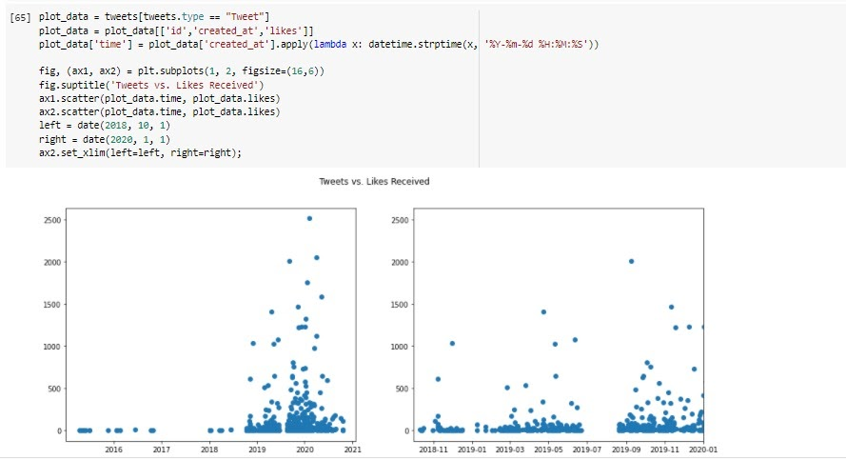
The number of likes per tweet per year vs number of likes per tweet from 2018-2020 by month:

Slide 16
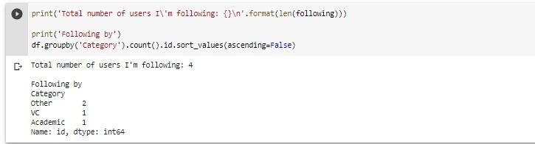
UNSTRUCTURED DATA
Twitter API delivers an unstructured data JSON file.
Analyzed the tweets by taking a group of the user’s follower’s and sorting them by category count by using 3 criteria (VC, Academic and other).
Selected data based on a category (categorical data based):

Slide 17
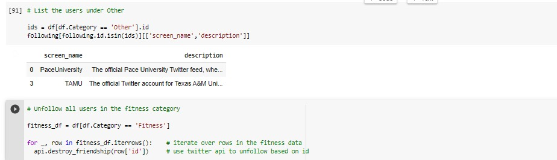
SELECT DATA BASED ON A CATEGORY (CATEGORICAL DATA BASED)
Breakdown the data even further by creating a list to see the users under the “other” category.

Slide 18
CHALLENGES
Unstructured data affects query processing performance and contributes to the difficulty of the user to manage or retrieve the data.
Many attempts have been made to reorganize or directly process these data. The Twitter dataset limited us from running many queries such as Slicing Data, Representing data in matrix form, Upload data to Numerical Python, performing mathematical and statistical functions using libraries and using a HeatMap.
This project helps in understanding unstructured data and in addressing important issues that affect query processing which otherwise meaningless if those were not well managed.

Slide 19
NETFLIX
STRUCTURED
DATA

Slide 20
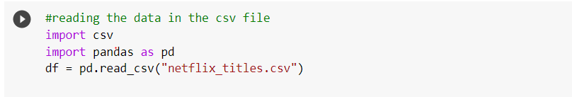
LOADING DATA IN TO DATAFRAMES
Imported Pandas and read the data into a data frame:

Slide 21
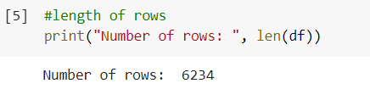

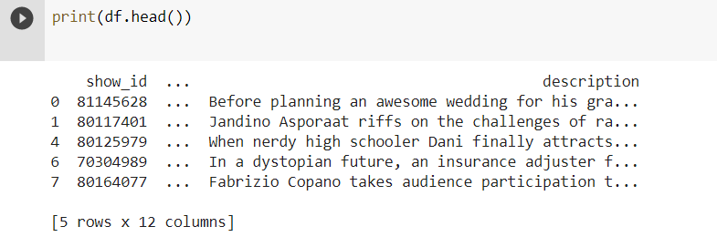
DATA TYPES OF THE DATA COLUMNS
List of columns
Number of rows in the data
The first five rows of the data

Slide 22
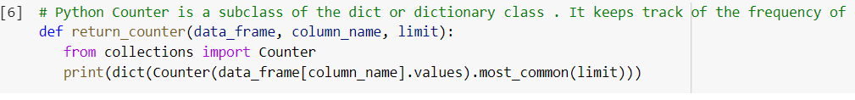
Here define a function that takes as input a data frame, column name, and limit. When called, it prints a dictionary of categorical values and how frequently they appear:
We applied our function to the ‘country’ column and limit our results to the five most common values:
We have 2,032 titles in the US, 777 in India, 476 missing country values, 348 in the UK, and 176 in Japan.

Slide 23
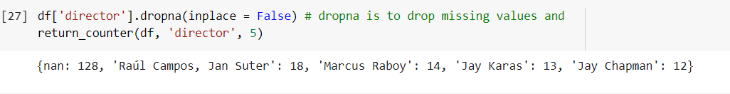
DROP ANY NULL, MISSING VALUES OR UNWANTED COLUMNS
Applied a function to the ‘director’ column, dropping missing values by using dropna (drop if even one element is missing)

Slide 24
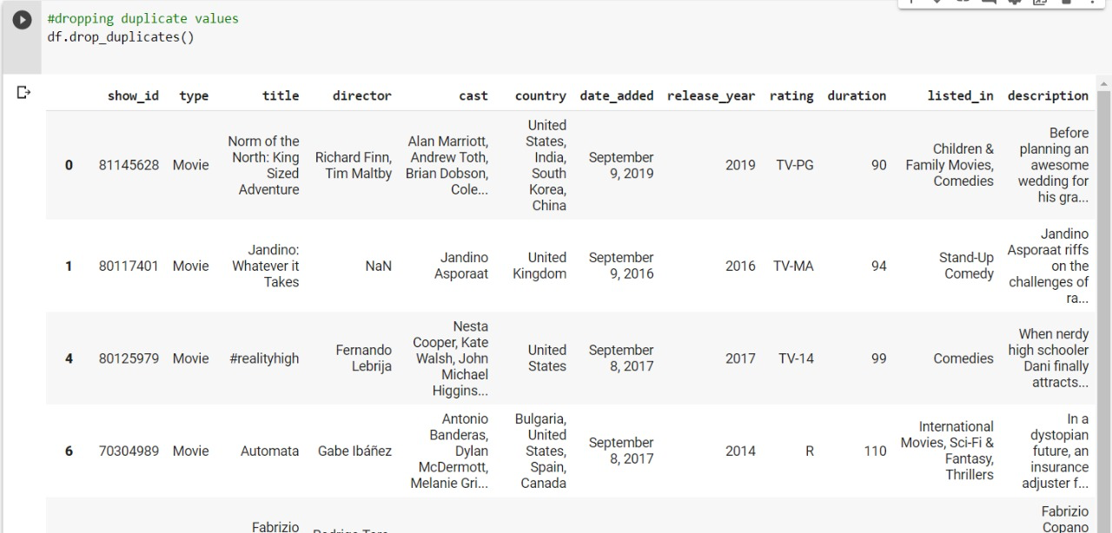
DROP DUPLICATE VALUES
Used Drop_duplicates which deleted duplicate rows based on all columns

Slide 25
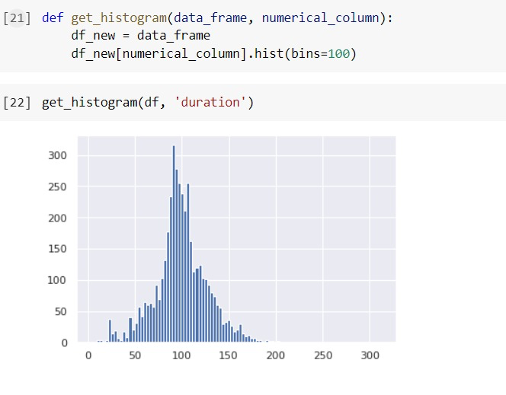
CHECK FOR OUTLIERS USING A BOX PLOT OR HISTOGRAM
A histogram is an accurate graphical representation of the distribution of numerical data. It takes as input one numerical variable only. The variable is cut into several bins, and the number of observation per bin is represented by the height of the bar.

Slide 26
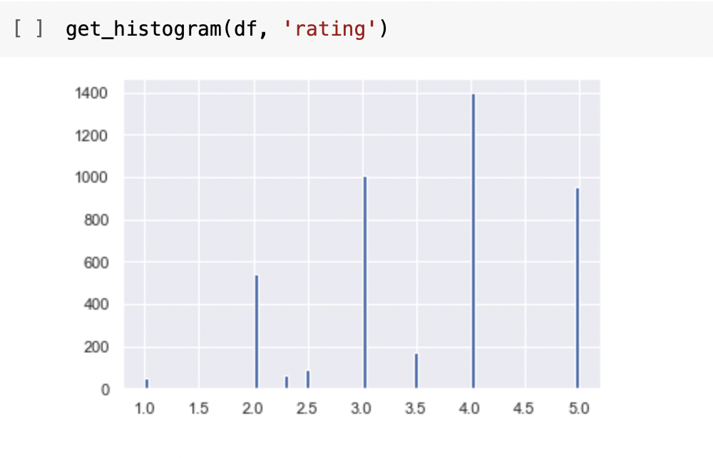
Ratings For Movie
Display number of ratings given to the movie in the form of histogram:

Slide 27
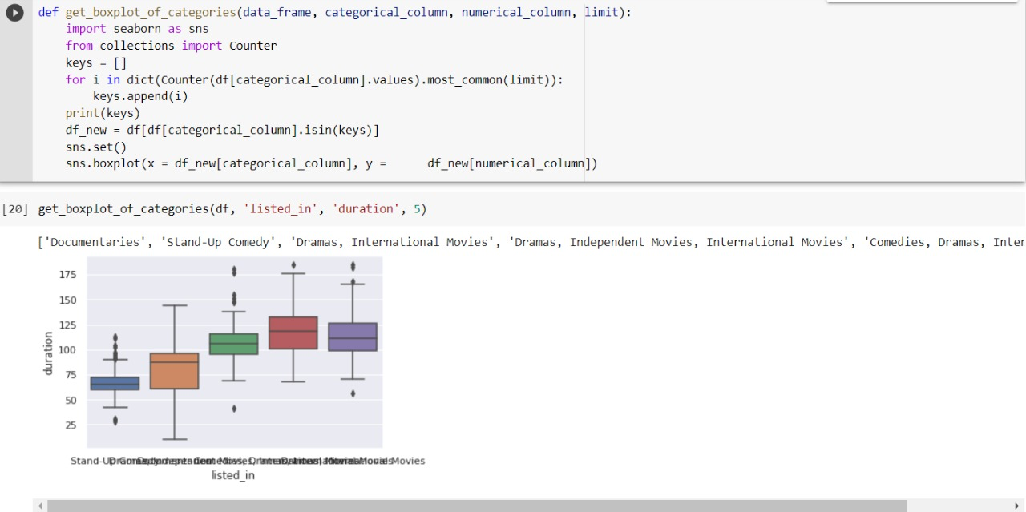
A Box Plot is also known as Whisker plot is created to display the summary of the set of data values having properties like minimum, first quartile, median, third quartile and maximum. In the box plot, a box is created from the first quartile to the third quartile, a verticle line is also there which goes through the box at the median. Here x-axis denotes the data to be plotted while the y-axis shows the frequency distribution.
Displaying most common genres according to “listed_in” data based on duration of each video.
Box Plot For duration of categorical movies

Slide 28
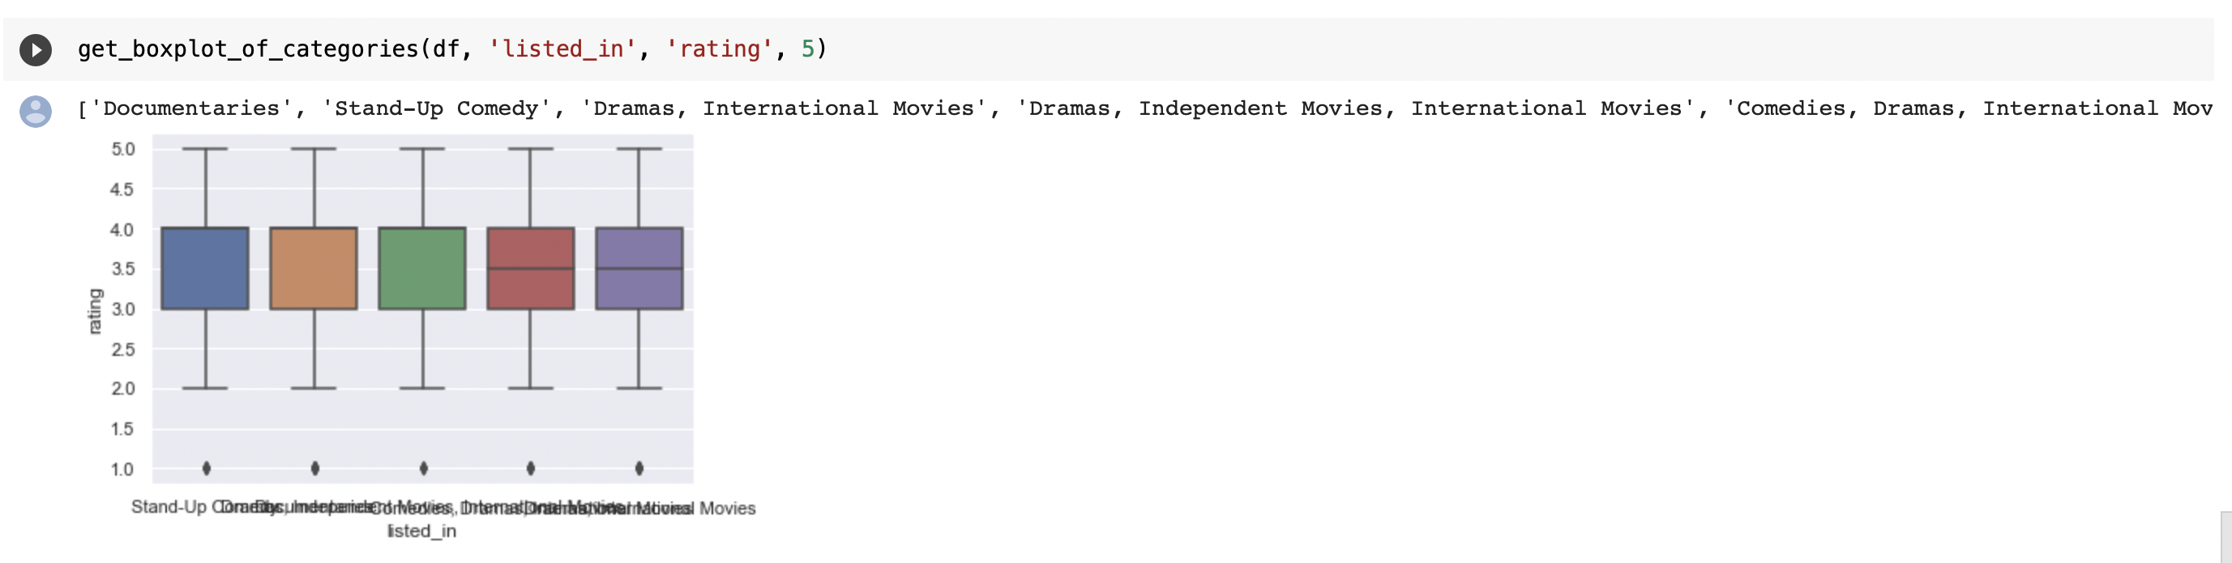
Ratings for according movie categories
Count the number of rating according to the category of movie:

Slide 29
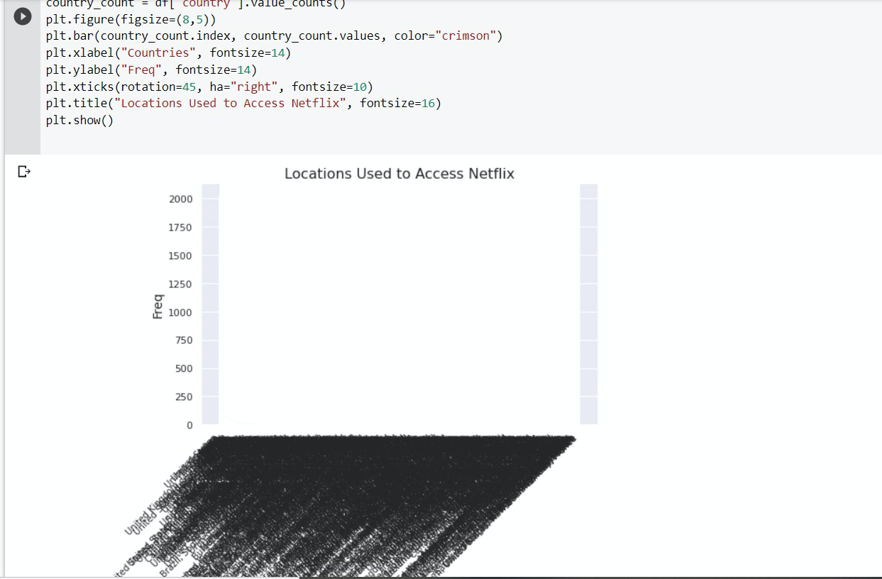
MAT PLOT LIB
Which countries access Netflix:

Slide 30
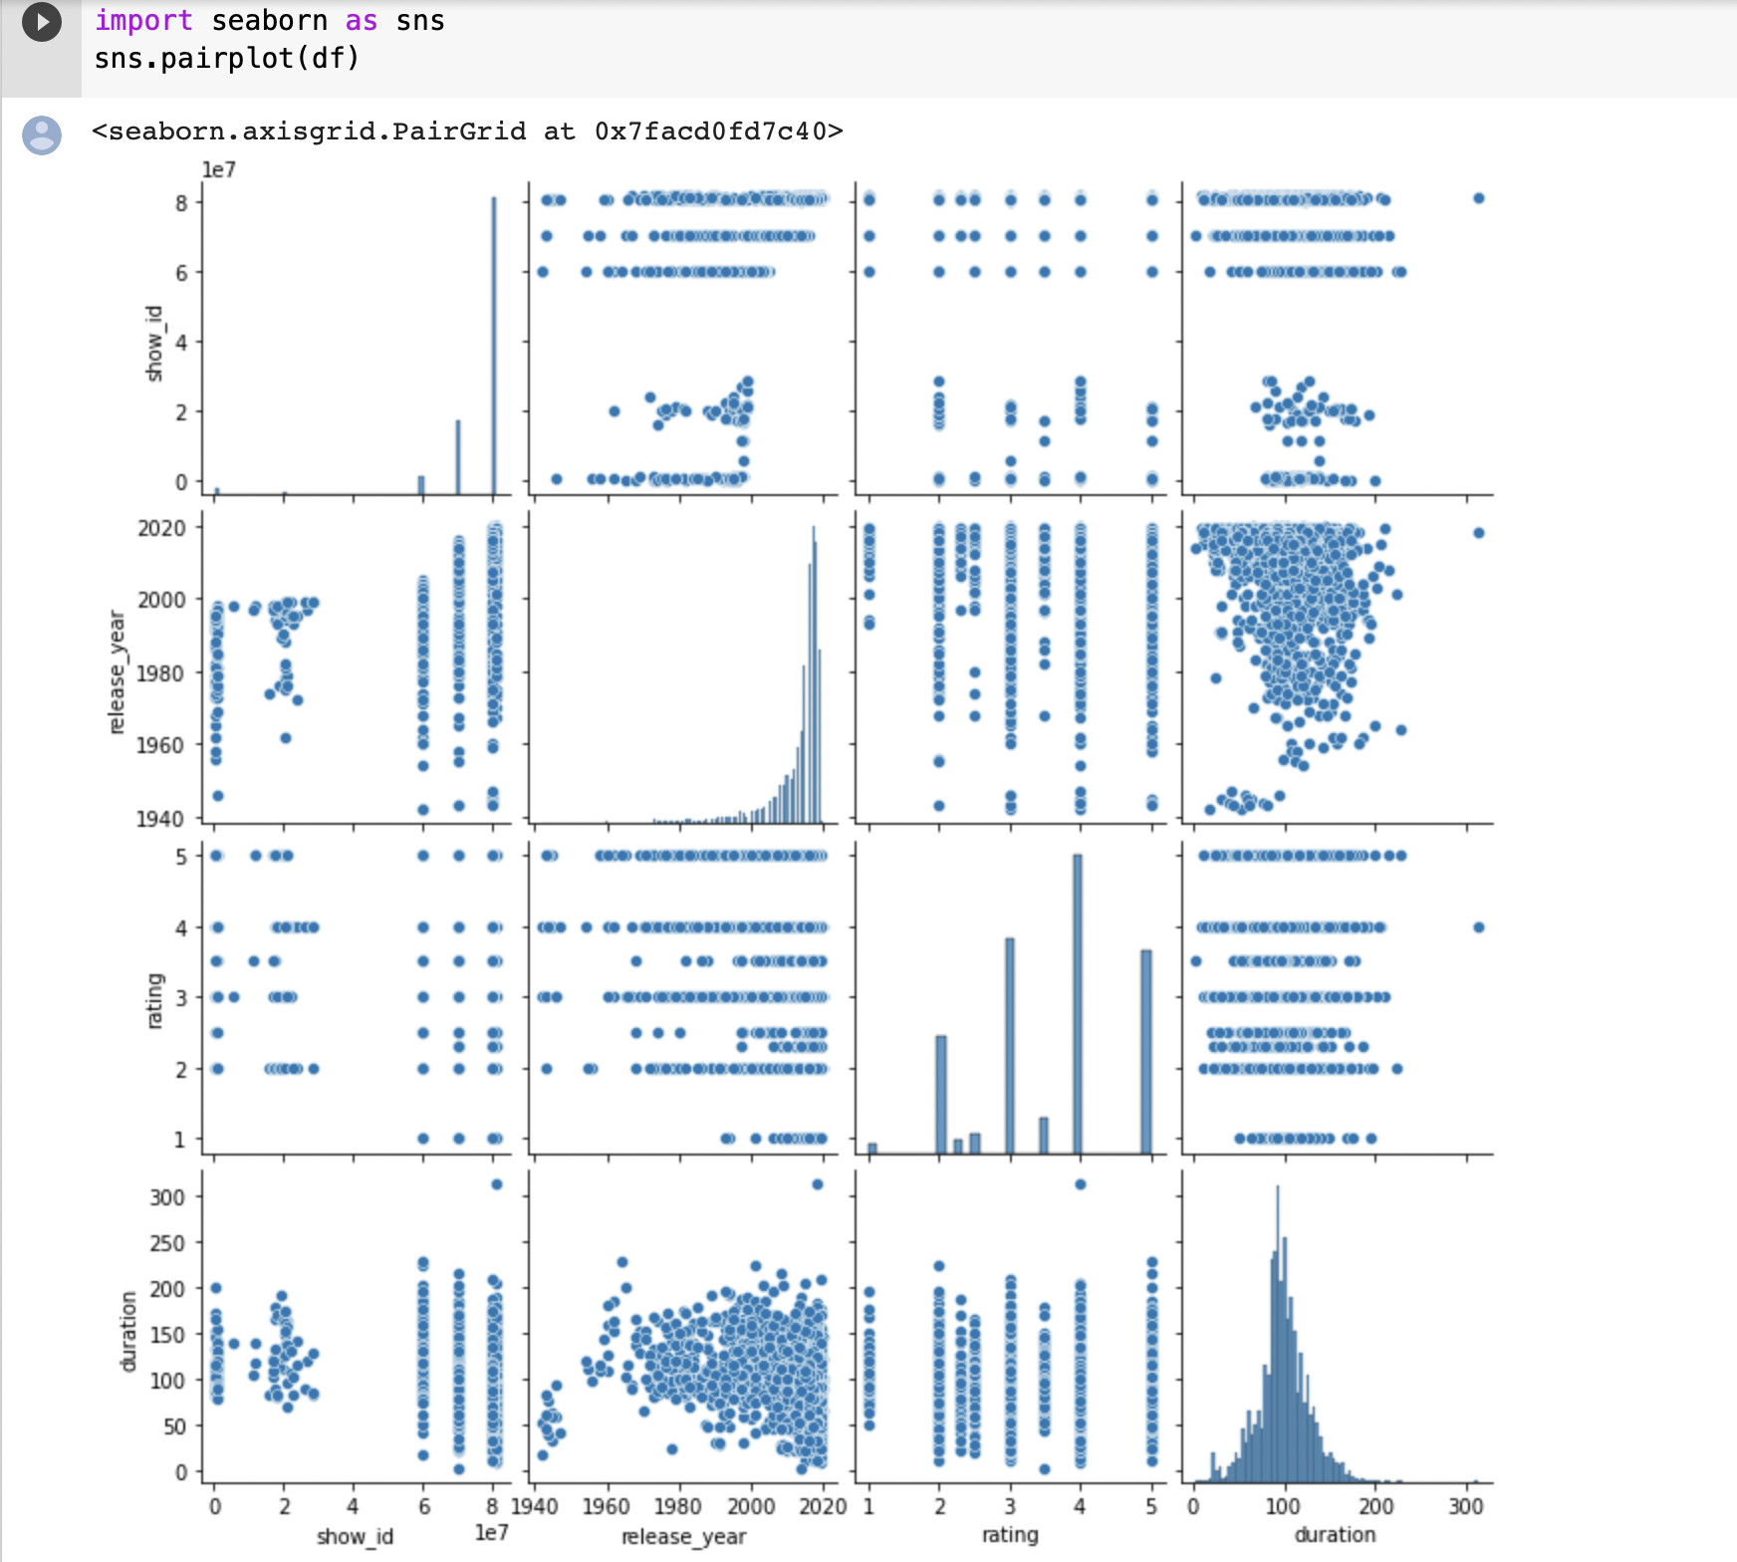
PLOT FEATURES AGAINST EACH OTHER USING A PAIR PLOT
The pairplot function creates a grid of Axes such that each variable in data will be shared in the y-axis across a single row and in the x-axis across a single column. That creates plots as shown below:
The pairplot plot is shown in the image below. The data set has 4 measurements: show_ID, release_year, rating, duration . The data contains measurements of different Netflix Videos.

Slide 31
Pair Plot
This dataset is often used in machine learning, because the measurements and classes (videos) provide an excellent way to distinguish movies or shows.
The data is mapped in the grid below. Because there are 4 measurements, it creates a 4x4 plot.

Slide 32
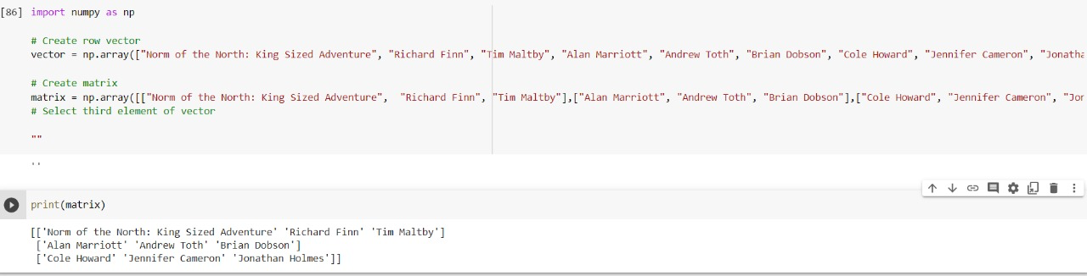
UPLOAD DATA TO NUMERICAL PYTHON (NUMPY) & CREATING A MATRIX
NumPy is the foundation of the Python machine learning stack. NumPy allows for efficient operations on the data structures often used in machine learning: vectors, matrices, and tensors. While NumPy is not the focus of this project, it will show up frequently. This covers the most common NumPy operations we are likely to run into while working on machine learning workflows.
Created a matrix in NumPy by using lists. np.array is used to create NumPy array from a list. It represents a 2D matrix where input to np.array() is a list of lists [[]] . Each list in the parent list forms a row in the matrix.
The output of the program is:

Slide 33
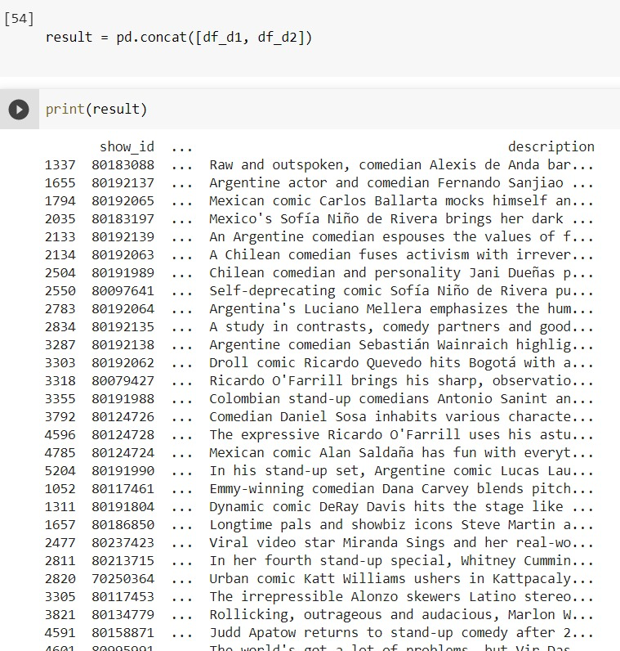
MERGING TWO DATA FRAMES
I have taken show description and show name data sets and combines into one list by using the concat function:

Slide 34
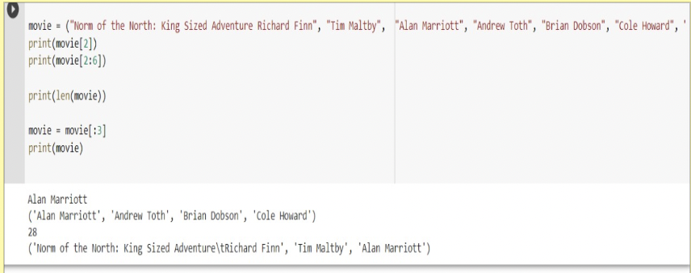
SLICING DATA
Slicing the range of the movies title based on the length. The data sliced using indexing.

Slide 35
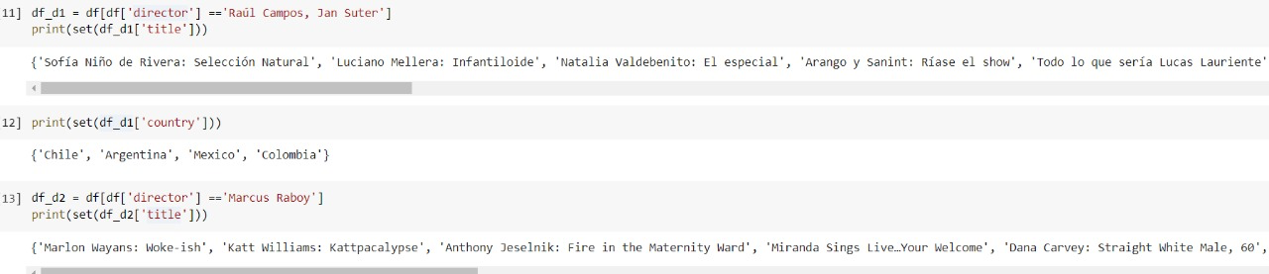
USE CONDITIONS AND SEGREGATE THE DATA BASED ON THE
The titles from the most common directors ‘Raul Campos’ and ‘Jan Suter’ and countries:
Same with for Marcus Raboy but here we’ll analyze movie durations. First, I need to filter the data set to only include movie titles

Slide 36
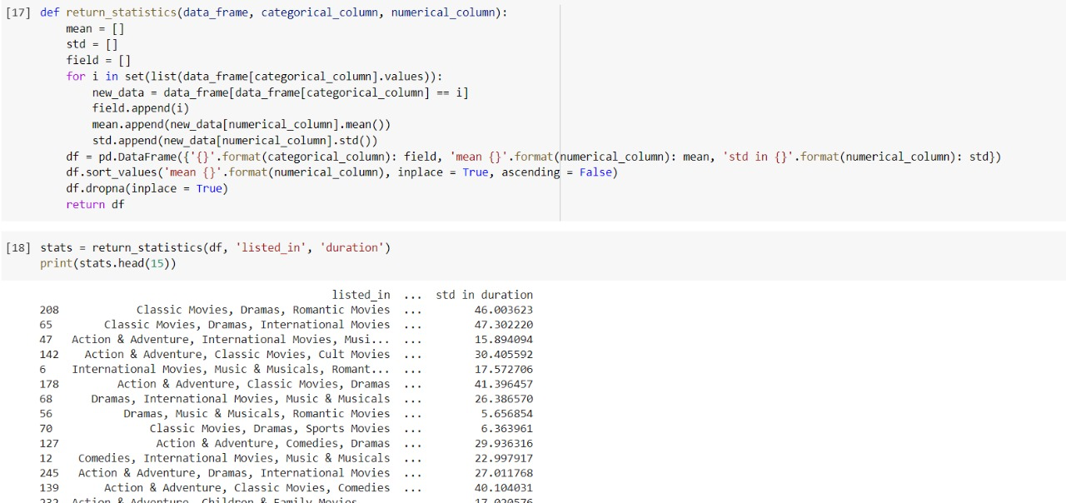
USE MATHEMATICAL AND STATISTICAL FUNCTIONS USING LIBRARIES
It would be useful to generate summary statistics from numerical columns like ‘duration’. Let’s define a function that takes a data frame, a categorical column, and a numerical column. The mean and standard deviation of the numerical column for each category is stored in a data frame and the data frame is sorted in descending order according to the mean. This is useful if you want to quickly see if certain categories have higher or lower mean and/or standard deviation values for a particular numerical. Call function with categorical column ‘listed_in’ and numerical column ‘duration’.

Slide 37
Thank You

